Slide 1
MENTAL HEALTH AND WELL-BEING Awareness PRESENTATION

Slide 2
What is mental well-being
Why is it important
Mental health awareness in the workplace
Window on the world
The stress bucket
Tips to reduce stress
How we are working to support you
Further advice

Slide 3
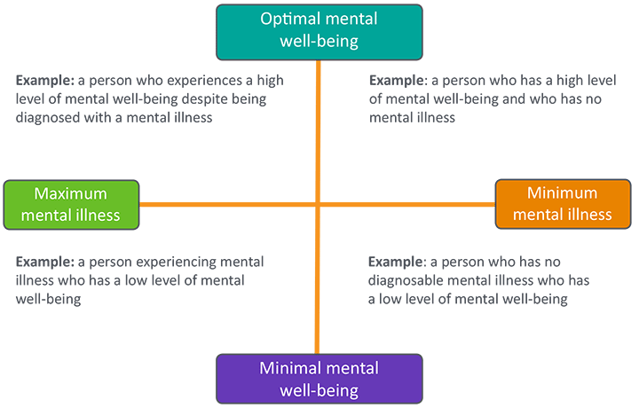
Everyone has mental health
We all have mental health
Just like our physical health, it goes up and down
Having good mental health can help us feel better, sleep better and support us in doing the things we want to do
It can also help us have more positive relationships with those around us
We don’t need to wait until we are struggling with our mental health
There are lots of things we can do to protect our mental health and stop issues from getting worse, just as we do with our physical health
Notes:
The correct way to view mental health is that we all have it and we fluctuate between thriving, struggling and being ill and possibly off work. People with poor mental health including common mental health problems and severe mental illness can be in any of these groups. An individual can have a serious mental health problem but – with the right support – can still be thriving at work. Equally someone without mental health issues, can experience poor mental health if they experience high levels of stress. We all have different levels of mental well-being, and at different times we may move in and out of different levels of mental wellbeing (between good and bad mental wellness), depending on our current situation, personal and environmental stress levels that we are experiencing.

Slide 4
Why it is so important in the workplace
There is a duty of care on the employer to ensure there are adequate arrangements in place to ensure the welfare at work of there employees and this also means their mental welfare.
(Section 2 (e) Health and Safety at Work At 1974 defines the general duties of care of an employer to his staff and paragraph around well-being at work)
Recent research has highlighted the problems connected with mental health well-being in the workplace with up to 1 in 3 workers affected in some way and the associated human cost
As always there is a financial cost too – the Mental Health Foundation in the UK estimate this to be a massive £225 billion
Notes:
Section 2 (e) Health and Safety at Work At 1974 defines the general duties of care of an employer to his staff and paragraph around well-being at work.
The provision and maintenance of a working environment for his employees that is, so far as is reasonably practicable, safe, without risks to health, and adequate as regards facilities and arrangements for their welfare at work.
A recent sea change is evident in how stress in the workplace is enforced by the Health and Safety Executive (HSE) as the enforcing body and connecting it with workplace incidents notified to them. Mental health issues including mental illness are now regarded as one of the most significant issues in the workplace in Britain. Recent research has assessed that one in three workers is impacted by problems connected with mental health. The financial cost is estimated by the Mental Health Foundation in the UK as £225 billion (yes billion) per year. If staff are off sick this is obviously costly to the organisation, but there is also the human cost associated with this.
Mental health is a pressing issue for employers all over the UK. Research shows that 300,000 people lose their jobs every year because of a long-term mental health problem, and four in ten (39%) employees say work has contributed to their mental health problems over the last 12 months.
And, when people are experiencing mental health issues but are not given the right support, their productivity suffers – missed work days, difficulty concentrating or even resignation is a possible outcome. These factors add up to an annual cost of up to £99 billion per year for the economy – with £42 billion of that a direct cost to employers.
https://www.mentalhealthatwork.org.uk/

Slide 5
The workplace is a shared and important environment for us all
We don’t know the baggage that people carry and private matters should be kept private
However, our actions – or lack of action can have an adverse effect on others – we might not consider this because we don’t know others circumstances
We should be aware of this in our workplace as we all carry a shared responsibility

Slide 6
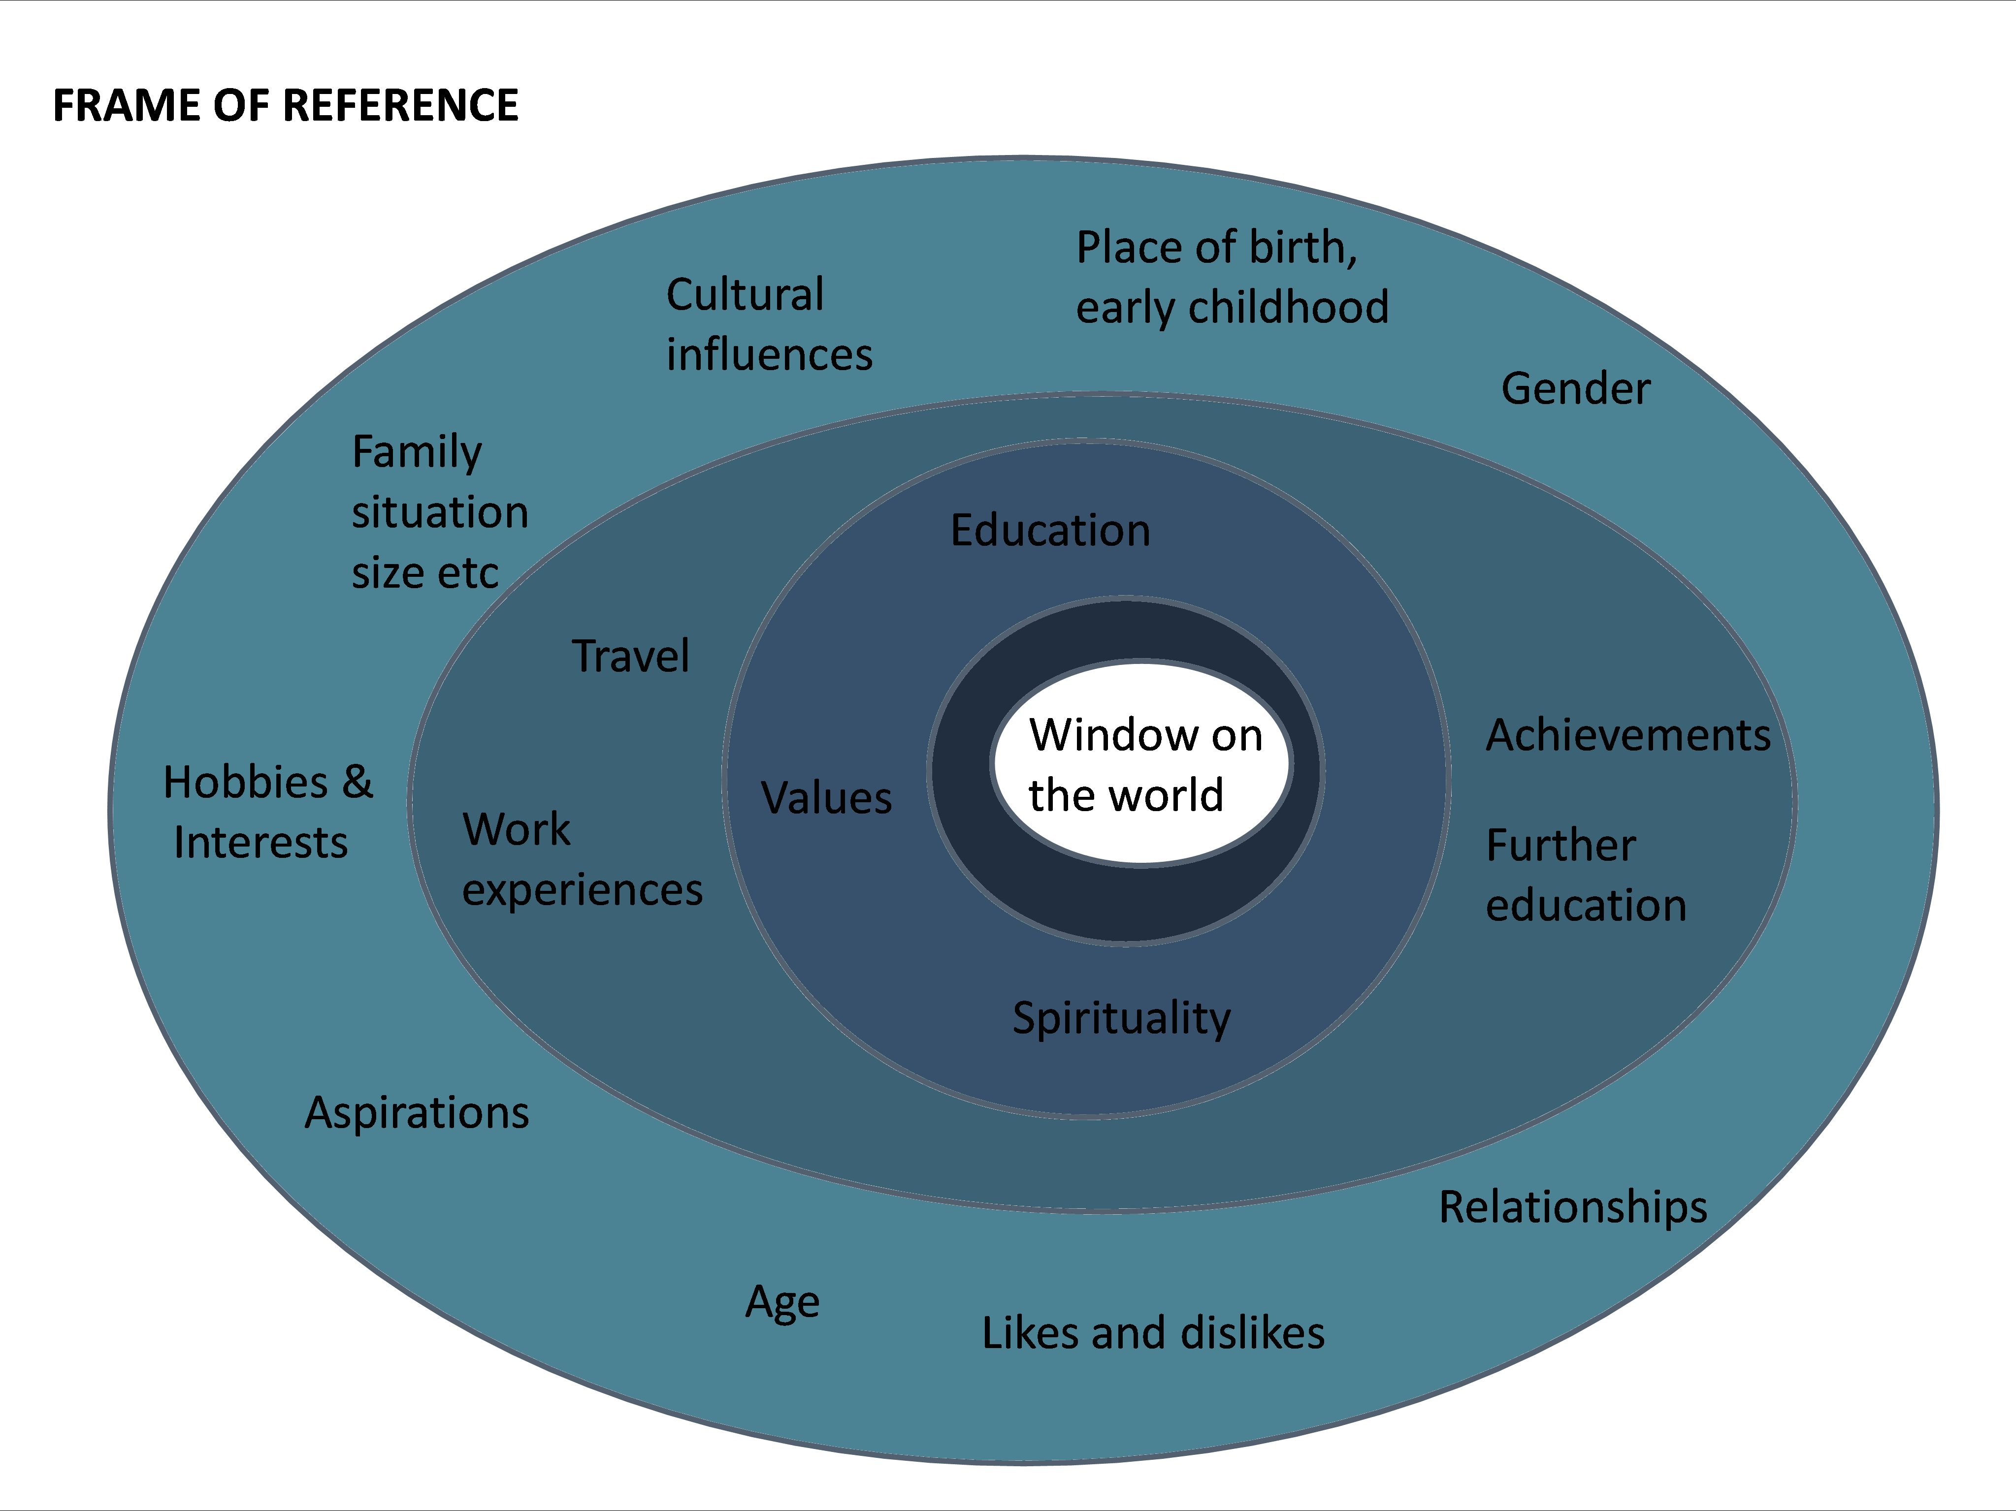
Notes:
The frame of reference is the term used by Jacqui and Aaron Schiff to refer to our individual filter on reality.
They defined the frame of reference as: “The structure of associate responses which provide the individual with an overall perceptual, conceptual, affective and action set, which is used to define the self, other people and the world”.
Our individual frame of reference is influenced by a range of factors from our upbringing and experience. These include our family situation, education, culture and life experiences.
This highlights how stress is subjective, and everyone reacts differently. Individuals may experience more stress / be less able to cope with stress in the work place based on other events happening outside of work (i.e. if they are experiencing problems in their home life) and based on their past experience i.e. if they have been bullied in the workplace in the past. The bottom line is - Stress is subjective, everyone's perspective and ability to cope with stress is different and we need to be mindful of this. Therefore this policy aims to reflect this by developing a range of approaches to address mental health and well-being in a variety of ways.

Slide 7
Our individual frame of reference is influenced by a range of factors from our upbringing and experience. These include our family situation, education, culture and life experiences.
This highlights how stress is subjective, and everyone reacts differently. Individuals may experience more stress / be less able to cope with stress in the work place based on other events happening outside of work (i.e. if they are experiencing problems in their home life) and based on their past experience i.e. if they have been bullied in the workplace in the past. The bottom line is - Stress is subjective, everyone's perspective and ability to cope with stress is different and we need to be mindful of this. Therefore this policy aims to reflect this by developing a range of approaches to address mental health and well-being in a variety of ways.
Our past experiences and vulnerability affect how we cope with stress (the size of our stress bucket).

Slide 8
Work related stress
What causes stress?
There can be a variety of causes of stress. For example, financial problems, difficulties in personal relationships or moving house can all cause stress. Work can also cause stress. The HSE (Health and Safety Executive) has identified the six primary causes of work-related stress to be:
The demands of the job - staff can become overloaded if they cannot cope with the amount of work or type of work they are asked to do
Amount of control over work - staff can feel disaffected and perform poorly if they have no say over how and when they do their work
Support from managers and colleagues - levels of sickness absence often rise if staff feel they cannot talk to managers about issues troubling them
Relationships at work - a failure to build relationships based on good behaviour and trust can lead to problems related to discipline, grievances and bullying
How a role fits within the organisation - staff will feel anxious about their work and the organisation if they don't know what is expected of them and/or understand how their work fits into the objectives of the organisation
Change and how it is managed - change needs to be managed effectively or it can lead to huge uncertainty and insecurity.

Slide 9
When we worry it can feel like a chain of thoughts and images, which can progress in increasingly catastrophic and unlikely directions.
It is easy for thoughts to get out of hand if we let them.
This is known as the worry chain.

Slide 10
Worry isn’t just in our heads. When it becomes excessive we feel it as anxiety in our bodies too.
Physical symptoms of worry and anxiety include:
• Muscle tension or aches and pains.
• Restlessness and an inability to relax.
• Difficulty concentrating.
• Difficulty sleeping.
• Feeling easily fatigued.

Slide 11
Strong triggers for worry are situations that are:
• Ambiguous – open to different interpretations. •Novel and new – so we don’t have any experience to fall back on.
• Unpredictable – unclear how things will turn out.
The current worldwide health situation ticks all of these boxes, and so it makes sense that people are experiencing a lot of worry. It is an unusual situation with much uncertainty, which can naturally lead us to worry and feel anxious.
It is natural to worry at this time; Human beings have the amazing ability to think about future events. 'Thinking ahead’ means that we can anticipate obstacles or problems, and gives us the opportunity to plan solutions. When it helps us to achieve our goals, ‘thinking ahead’ can be helpful. For example, hand washing and social distancing are helpful things that we can decide to do in order to prevent the spread of the virus. However, worrying is a way of 'thinking ahead' that often leaves us feeling anxious or apprehensive. When we worry excessively, we often think about worst case scenarios and feel that we won't be able to cope.

Slide 12
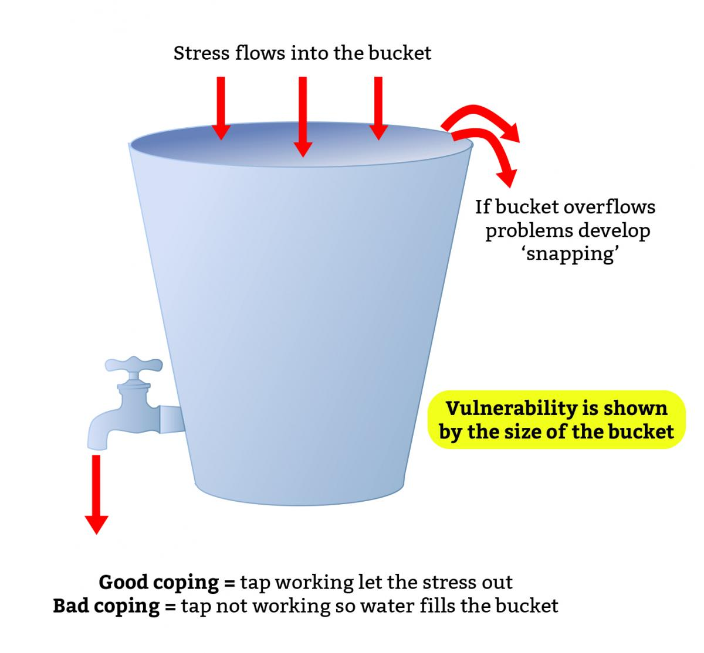
The Stress Bucket
Recognise when you are stressed and take action.
Reduce areas of stress when you can – avoid stressful events such as taking exams when you know you will be having other stressful events happening.

Slide 13
Spotting signs of stress
While identifying work-related risks and taking preventative measures should help minimise stress for most staff, it may still affect some team members due to issues inside or outside of the workplace. Managers should be prepared to help and support a team member experiencing stress.
Although training on stress can be very useful, a manager should not be expected to be an expert.
It is important to never make assumptions, but signs that a team member may be stressed include:
changes in the person's usual behaviour, mood or how they interact with colleagues
changes in the standard of their work or focus on tasks
appearing tired, anxious or withdrawn and reduced interest in tasks they previously enjoyed
changes in appetite and/or increase in smoking and drinking alcohol
an increase in sickness absences and/or turning up late to work.

Slide 14
Talking to a team member who maybe experiencing stress
Where a manager thinks a team member may be experiencing stress, they should approach the matter in the same way set out in the guidance on Managing staff experiencing mental ill health. This is because without talking to the team member, it is impossible to know what is affecting them and therefore a consistent approach should be taken.
Additionally, organisations should encourage staff to talk to their manager if they think they are becoming unwell. Creating a working environment that proactively supports staff who become unwell will make it easier for staff to tell their manager if they are experiencing stress.
For more information on how to do this, go to Promoting positive mental health in the workplace.
If a team member does approach their manager to advise they are experiencing stress, the manager should:
move the conversation to a private space, where they will not be disturbed (if not already somewhere appropriate)
thank the team member for coming to them and letting them know
be patient and allow them as much time as they need to talk about it
remain focused on what they say
be open minded
try to identify what the cause is
think about potential solutions.
If the cause of stress relates to their relationship with their manager, or other team members, it may be beneficial to involve Human Resources, if the organisation has one, or a more senior manager and allow the team member to have a companion (such as a work colleague or trade union representative) at any meetings.

Slide 15
Supporting a team member who maybe experiencing high amounts of stress
Where it is possible to identify a work-related problem, a manager (in discussion with the team member) should consider what support or changes would rectify the situation. They could be temporary or permanent.
Usually small, simple changes to working arrangements or responsibilities will help ease pressures affecting the team member.
It may take a number of informal meetings with the team member to agree the best way forward. Some changes may also require authorisation from senior management, HR or the owner of the business. A manager should explain if they believe a potential change may require authorisation and when an answer should be received. If authorisation is refused, a manager should clearly explain the reasons why this was not practicable and try to find an alternative solution.
If changes are agreed and made, a manager should also agree with the team member what their work colleagues will be told.
Even if the cause of stress may not be work-related, changes to the team member's working arrangements may help reduce some of the pressure they are experiencing. For example, temporarily changing their working hours may reduce stress caused by caring responsibilities for an ill-relative.

Slide 16
Taking steps to reduce work-related stress / consider a stress risk assessment
An employer should develop an action plan that includes:
what the problem is
how it was identified
the proposed solution/s
actions to be taken to achieve the solution/s
dates by which each action should be achieved
how staff will be kept informed on progress
a date to review the plan and see if it has achieved its aim.
Once solutions have been implemented, the review should check that agreed actions have been done and evaluate how effective these have been. The views of staff, and data collected on employee turnover, sickness absence and productivity, can help compare the organisation against how it was before the action plan was implemented.
An employer will then need to consider what, if any, further action is needed.

Slide 17
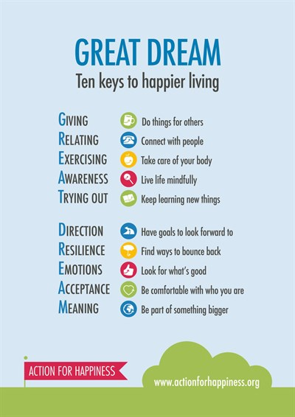
Take action to improve your well-being
Competence and confidence help to reduce stress. Therefore, it is important that everyone has the appropriate level of training. If you feel you need further training for your role, please discuss this with your manager.
Take a break
Take a walk
Talk to someone
Develop coping strategies (mindfulness)
Practise good financial management to avoid any extra stress
Tell a manager if you are stressed
Have a healthy diet
Ensure you get enough sleep
Exercise regularly
Have fun and relaxation
Get plenty of fresh air

Slide 18
Top tips for reducing stress
Being active reduces stress, increases energy levels, and can make us more alert and help us sleep better. Find ways to add a bit of physical activity into your day. Why not try getting off the bus or train a stop earlier, or taking the stairs more often?
Focus on quality time; Plan to spend quality time with your family or friends each week. If you live with other people, switch off the TV and spend some time together – and if not, make plans to meet up.
Be prepared and feel calm; If you have a busy day or week coming up, spend a little time planning before you go to bed. Think about what you can organise or pack the night before, and plan some short breaks in each day.
Make time every day to reflect on what went well. It's important to recognise your successes and the things you are grateful for, no matter how small.
Make time to do something that you enjoy; Big or small, make time for you. From going to the cinema, listening to music or reading a book, making time to do the things you enjoy can help you feel more positive and improve your wellbeing.

Slide 19
Reframe unhelpful thoughts; The way we think, feel and behave are linked. Sometimes we develop patterns of thoughts or behaviours that are unhelpful so recognising them, and taking steps to think about things differently, can improve your mental health and wellbeing.
Be in the present; If we take time to be aware of ourselves and be in the present moment, noticing our own thoughts and feelings, and the world around us, we can gain a better perspective. Sometimes this is known as being more mindful.
Get good sleep; Good-quality sleep makes a big difference to how we feel mentally and physically, so it's important to get enough.
Connect with others; Spending quality time with friends or family, talking to someone about how we are feeling, or finding ways to help other people can all help stop you from feeling lonely and improve your mental health and wellbeing.
Live a healthy life; Being active, enjoying the outdoors and having a healthy, balanced diet all impact how we feel. Also, binning bad habits like smoking, and cutting down on alcohol and caffeine can have a positive effect on our mood.
Do something for yourself; From enjoying your favourite hobby, learning something new or simply taking time to relax, it's important to do things that make you happy.

Slide 20
Put things into perspective
Imagine yourself 10 years from now looking back at this day, at this very moment. What will be your thoughts about this very moment 10 years from now? You'll quickly realize that there is a 95 percent possibility that you won't even remember this very moment. And for the five remaining percent that you will remember you'll probably end up laughing about it. So is it really worth it to get all upset about it?
Just look at the situation and imagine how it could have been worse and that for a matter of fact you’re actually well off by making your brain come up with alternative scenarios to what's currently happening.

Slide 21
Take up a new hobby
Do something creative – painting, creative writing
Keep a journal
Exercise, yoga and fresh air where you can. If you can’t get out and don’t have a garden you can use stairs if you have them or exercise via facebook or you tube videos.
arts and crafts, such as drawing, painting, collage, sewing, craft kits or upcycling
DIY
colouring
mindfulness
playing musical instruments, singing or listening to music
writing
meditation.
Try having a clear out. You could sort through your possessions and put them away tidily, or have a spring clean.
You could also have a digital clear out. Delete any old files and apps you don't use, upgrade your software, update all your passwords or clear out your inboxes.
Write letters or emails, or make phone calls with people you've been meaning to catch up with.
Keep your brain occupied and challenged. Set aside time in your routine for this. Read books, magazines and articles. Listen to podcasts, watch films and do puzzles.
Although high street library branches are closed, some libraries have apps you can use online. These allow you to borrow ebooks, audiobooks or magazines from home for free, if you're a library member.
FutureLearn and OpenLearn have free online courses you could try.
There are lots of apps that can help you learn things, such as a foreign language or other new skills.
Stay in contact with friends and family via facetime, zoom etc – have remote quizzes

Slide 22
Keep active
Build physical activity into your daily routine, if possible. Most of us don't have exercise equipment like treadmills where we live, but there are still activities you can do. Exercising at home can be simple and there are options for most ages and abilities, such as:
cleaning your home
dancing to music
going up and down stairs
online exercise workouts that you can follow
sitting less – if you notice you've been sitting down for an hour, just getting up or changing position can help.

Slide 23
Get some balance
An imbalance of pleasure, achievement, and closeness can affect our mood. For example if you spend most of your time working with no time for pleasure or socialising, then you may start to feel low and isolated. Conversely, if you spend most of your time relaxing for pleasure and not doing other things that are important to you then this can also impact your mood. At the end of each day could you check in with yourself and reflect on ‘what did I do today that gave me a sense of achievement? Pleasure? Closeness with others?’ Did I get a good balance, or what can I do differently tomorrow?

Slide 24
It is natural for you to worry, but if you feel that it's becoming excessive and taking over your life – for example if it's making you anxious, or if you're struggling to sleep – then it might be worth trying to find ways to limit the time you spend worrying, and taking steps to manage your well-being.

Slide 25
Worry can be helpful or unhelpful, and psychologists often distinguish between worries concerning ‘real problems’ vs. ‘hypothetical problems’.
• Real problem worries are about actual problems that need solutions right now. For example, given the very real concern about the virus at the moment, there are helpful solutions which include regular handwashing, social distancing, and physical isolation if you have symptoms.
• Hypothetical worries about the current health crisis might include thinking about worst-case scenarios (what we might call catastrophising). For example, imagining worst case scenarios such as most people dying.
Practise identifying whether your worry is 'real problem' worry, or 'hypothetical worry'. The Worry Decision Tree is a useful tool for helping you to decide what type your worry is.

Slide 27
Many of our normal routines and daily activities are changing. Naturally this can be unsettling, and we can find that the things we usually did to look after our well-being have become difficult. Whether you are working from home, or in some form of physical isolation or distancing, it can be helpful to organise a daily routine that involves a balance between activities that:
• give you a sense of achievement
• help you feel close and connected with others and
• activities that you can do just for pleasure.
We feel good when we have achieved or accomplished something, so it’s helpful to include activities each day that give you a sense of achievement. For example, doing some housework, decorating, gardening, a work task, cooking a new recipe, completing an exercise routine, or completing ‘life admin’ such as paying a bill.

Slide 28
Notice and limit worry triggers. As the health situation develops it can feel like we need to constantly follow the news or check social media for updates. However, you might notice this also triggers your worry and anxiety. Try to notice what triggers your worry. For example, is it watching the news for more than 30 minutes? Checking social media every hour? Try to limit the time that you are exposed to worry triggers each day. You might choose to listen to the news at a set time each day, or you could limit the amount of time you spend on social media for news checking.
Practice gratitude. At times of uncertainty, developing a gratitude practice can help you to connect with moments of joy, aliveness, and pleasure. At the end of each day, take time to reflect on what you are thankful for today. Try and be specific and notice new things each day, for example ‘I am grateful that it was sunny at lunchtime so I could sit in the garden’. You could start a gratitude journal, or keep notes in a gratitude jar. Encourage other people in your home to get involved too.

Slide 29
Useful websites;
https://www.acas.org.uk/index.aspx?articleid=6062
https://www.nhs.uk/oneyou/every-mind-matters
ttps://www.mind.org.uk/information-support/tips-for-everyday-living/workplace-mental-health/work-and-mental-health
https://www.mentalhealthatwork.org.uk/
https://mhfaengland.org/
https://www.gov.uk/government/publications/thriving-at-work-a-review-of-mental-health-and-employers

